Slide 1

Project 1 Deep Learning: Image Classification with CNN
Group 1: John-Baptist, Katy & Daan
Fri, 08.08.2025

Slide 2
Project Overview
PURPOSE :
Building a Convolutional Neural Network (CNN) to classify CIFAR-10 images
Using evaluation metrics to assess performance
Exploring transfer learning using VGG16
App deployment for image classification
DATASET :
60,000 images (32x32)
10 classes: Airplane, Automobile, Bird, Cat, Deer, Dog, Frog, Horse, Ship, Truck

Slide 3
Objective/ Task
To build a CNN model to classify images from a given dataset into predefined categories or classes

Slide 4
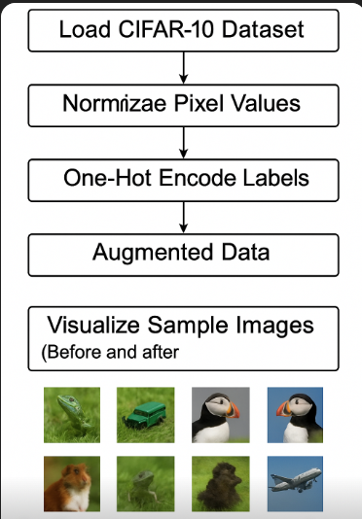
Data Preprocessing
Normalize Pixel Values

Slide 5
Model Architecture
Model Training
Created CNN model with keras from Tensorflow using sequential method:
Conv2D
MaxPooling layers
Dropout to reduce overfitting
Flatten & BatchNormalization
Dense layers with softmax for classification
Optimization of CNN model
Before training, we compiled the model
Experimented with different optimizers
Optimizers: Adam * & SGD
Loss: Categorical Crossentropy
EarlyStopping used to reduce overfitting
Epochs (10 + 5) for fine-tuning
Notes:
KATY

Slide 6
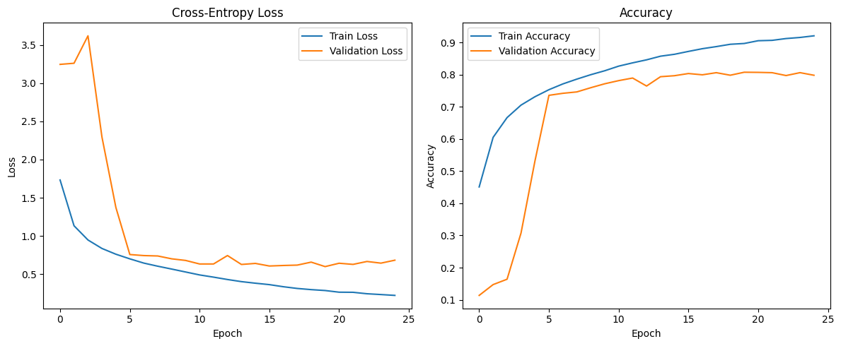
Evaluation Metrics
With Adam Optimizer:
Accuracy: 0.8076
Precision: 0.8100
Recall: 0.8076
F1-score: 0.8076

Slide 7
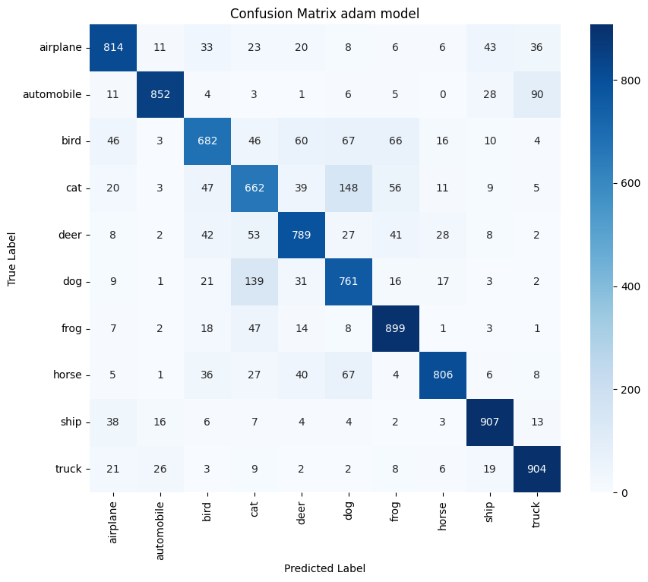
Confusion Matrix

Slide 8
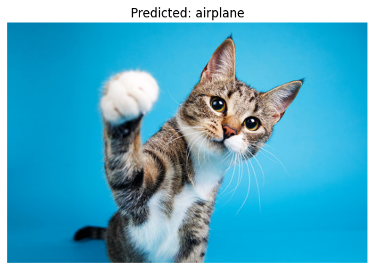
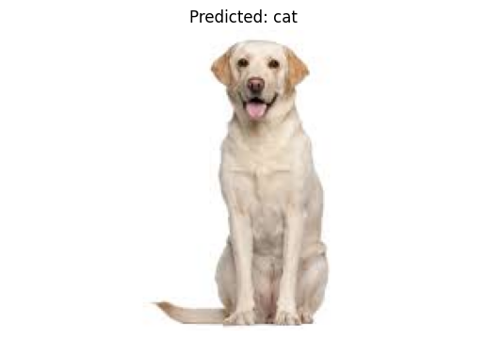
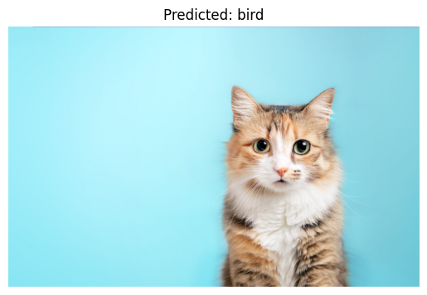
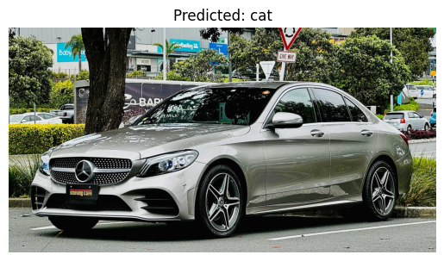
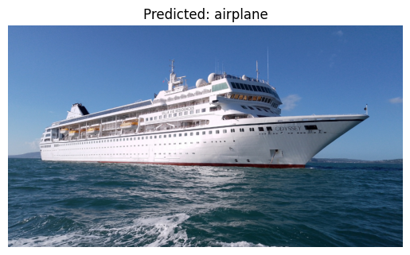
Misclassifications
Visualized wrong predictions
Most confusion: cat vs dog, cat vs automobile, etc..

Slide 9
Transfer Learning with VGG16
Resize to 224x224 (for VGG16)
Load VGG16 without top layer
Add custom classifier
Freeze base model
Fine-tune final layers

Slide 10
Model deployment
Created & deployed App using Gradio
Applied to custom datasets
Link to our new app deployed (demo): https://huggingface.co/spaces/DaanBooy/Image_Predictor

Slide 11
Conclusion
CNN model and VGG16 were effective
Fine-tuning boosted results
Strong baseline for image classification tasks
Although our CNN model worked well, model improvement is recommended
No big hurdles but usual questions cropping up and getting support
--------------------------------------
Thank you
Vielen Dank
Merci
Bedankt

Slide 12
References/ links
https://www.gradio.app/
https://huggingface.co/learn/computer-vision-course/unit2/cnns/vgg
https://keras.io/api/callbacks/learning_rate_scheduler/
https://keras.io/guides/serialization_and_saving/
https://keras.io/api/callbacks/model_checkpoint/
https://www.tensorflow.org/tutorials

Slide 13
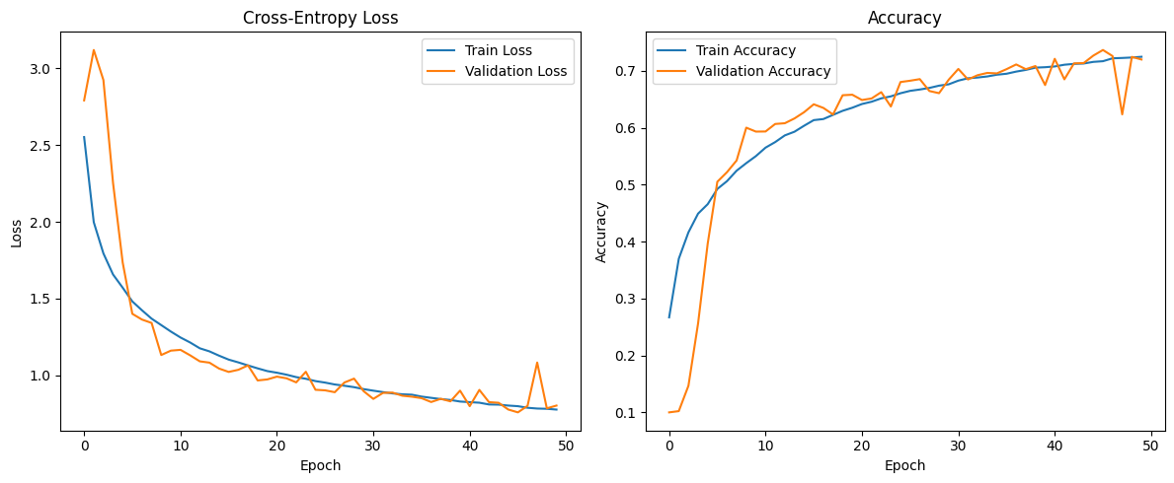
Evaluation Metrics
CNN model with SGD:
Accuracy: 0.7201
Precision: 0.7346
Recall: 0.7201
F1-score: 0.7174

Slide 14
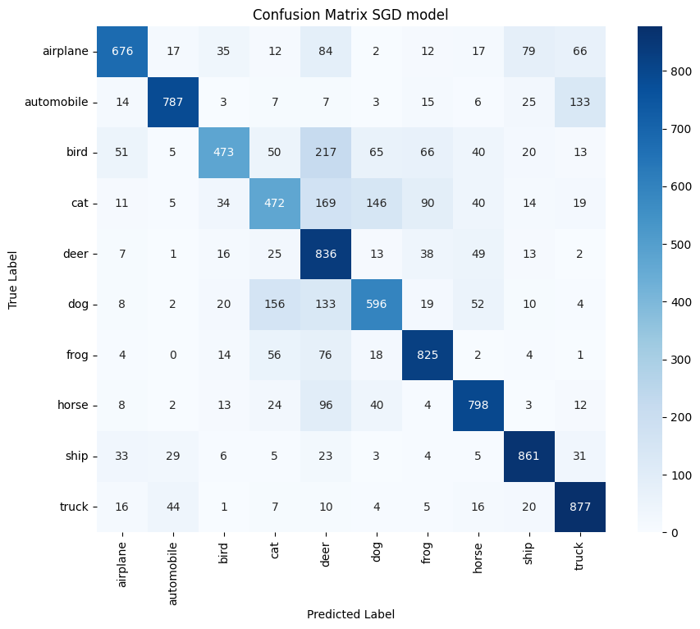
Evaluation Metrics
Confusion matrix for class-wise performance- SGD model

